Slide 1
Crop Price Prediction Using LSTM Model
Team Members:
Vijetha Pai
Sujan Acharya
Shravya
Shreyas S Tantri
Keerthi S M
Elroy Merwyn Monis
Neha Mashoora

Slide 2
Overview
Introduction
LSTM Model for Crop Price Prediction
Data Collection and Preprocessing
EDA, Feature Extraction and Sequence Generation
Model Architecture
Model Training and Model Evaluation
Hyper parameter tuning, Fine-tuning and Deployment
Conclusion

Slide 3
Introduction
Crop Price Prediction Using LSTM Model
Our project aims to predict Modal prices using an LSTM model, specifically for Arecanut (Coca) and Coconut (Grade-I) crops. We have collected and prepared a dataset from the Karnataka Krishi Marata Vahini government website spanning from 2015 to 2022. In this presentation, we will discuss our approach to preprocessing the data, extracting features, generating sequences, designing the model architecture, training and evaluating the model, tuning hyperparameters, and ultimately deploying the model to make accurate predictions.

Slide 4
Dataset Preprocessing
Prior to feeding the data into the LSTM model, we performed several preprocessing steps to ensure that the data was in a suitable format for training.
Data Cleaning
The data collected from the Karnataka krishi Marata vahini government website required cleaning to remove any missing or erroneous data points. We also removed any outliers that were changing the functions value abrutply.
Data Normalization
To ensure that the data was on the same scale, we normalized the data using Min-Max scaling. This ensured that all features had the same range of values and prevented any one feature from dominating the model's training.

Slide 5
Dataset Collection and Preparation
We have collected data for crops Arecanut(Coca) and Coconut(Grade-I) from Karnataka Krishi Marata Vahini government website spanning from 2015 to 2022. The data was collected in the form of CSV files.
Data Sources
Karnataka Krishi Marata Vahini government website
Data Collection Period
2015 - 2022
Data Format
xlsx format

Slide 6
Feature Extraction
Feature extraction is a crucial step in any machine learning project. In our project, we extracted features from the time-series data for Arecanut and Coconut crops. Initially the dataset had 10 columns which are as follows
Date
Market
Arrivals
Unit
Minimum price
Maximum price
Modal price
Variety
District
The features we extracted include:
Minimum Price
Maximum Price
Modal Price

Slide 7
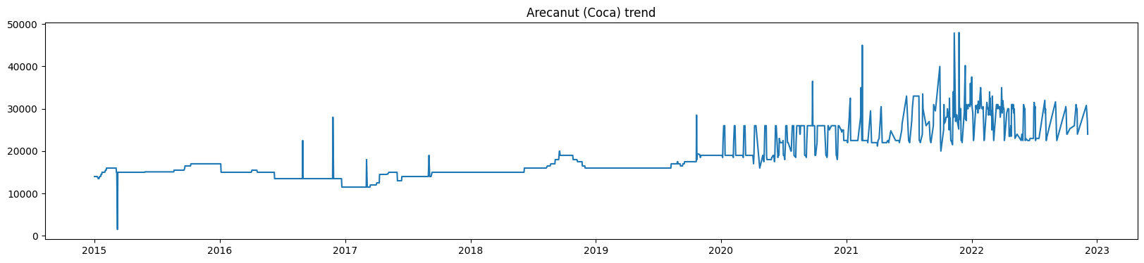
Arecanut (Coca) Trend 2015-2022

Slide 8
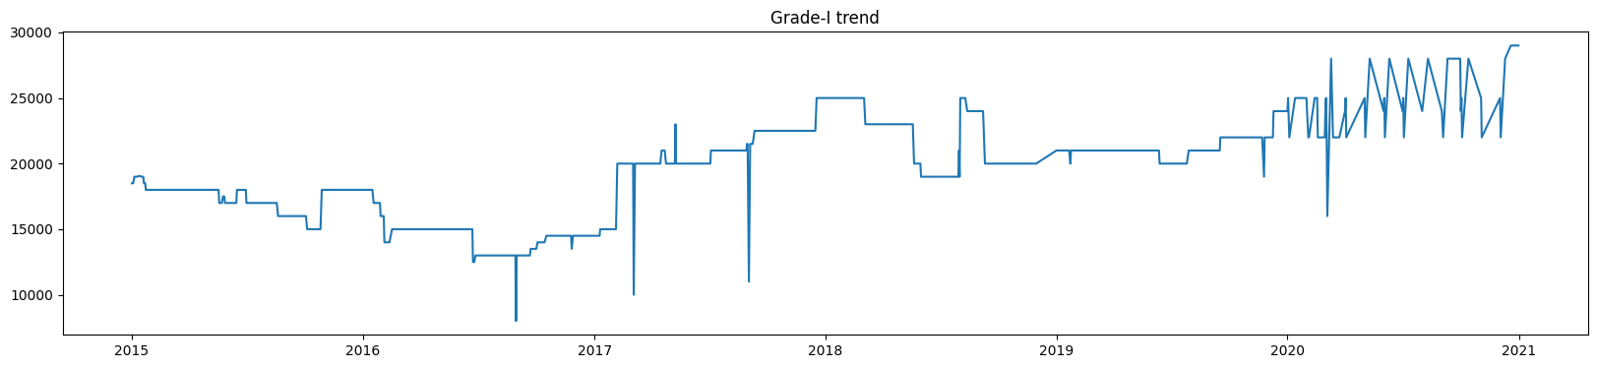
Coconut (Grade-I) Trend 2015-2022

Slide 9
Sequence Generation
Sequence generation for an LSTM model involves creating fixed-length sequences from sequential data, such as time series or text. It is required because LSTMs, as recurrent neural networks, are designed to capture patterns and dependencies in sequential data. By feeding these sequences to an LSTM, the model can learn and make predictions based on the temporal or sequential information in the data, making it suitable for tasks like natural language processing, time series forecasting, and more.
We have considered an input sequence of 3 days which implies that our LSTM model will be fed with previous 3 days of data to predict the next day's prediction.
The LSTM model requires its input to be in three dimensions, which can be given by (batch_size, input_sequence, number_of_features)
batch_size : Number of sequences in each batch.
Input_sequence : The number of time steps or elements in each sequence.
number_of_features : The dimensionality of each element in a time step, representing the number of features or variables.

Slide 10
Model Architecture
We have used Long Short-Term Memory (LSTM) for time series generation. LSTM is a type of Recurrent Neural Network (RNN) that is capable of learning long-term dependencies. It is particularly useful for time series data as it has the ability to remember past information and use it to predict future values.
Our LSTM model consists of five layers - an input layer, an LSTM layer, two Dense Layers and an output layer. The input layer takes in the sequence of historical prices for a given crop. The LSTM layer processes the sequence and generates a hidden state that captures the temporal dependencies in the data. The output layer then predicts the next value in the sequence based on the output generated by the last Dense layer.
The Dense layer uses ReLU (Rectified Linear Unit) activation function , The ReLU activation function is a commonly used non-linear function in neural networks. It replaces negative input values with zero and leaves positive values unchanged, helping the model learn complex patterns and speeding up training due to its simplicity. ReLU is widely used for hidden layers in deep learning models
Model Architecture:
model=Sequential()
model.add(InputLayer((3,3))),
model.add(LSTM(64)),
model.add(Dense(64, 'relu')),
model.add(Dense(30, 'relu')),
model.add(Dense(3)),

Slide 11
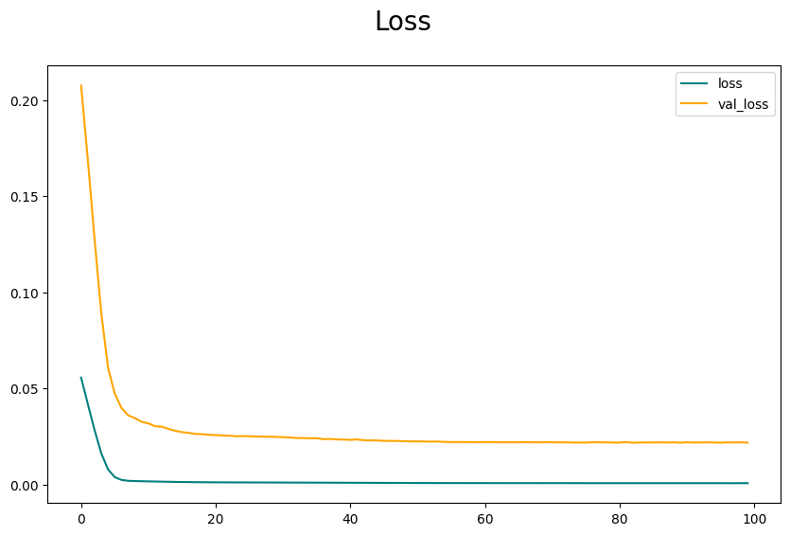
Model Training
Training Process
We trained our LSTM model on the preprocessed dataset using Keras API with Tensorflow backend. We used learning rate of 0.0001. The model was trained for 100 epochs.
Performance Metrics
We evaluated our model on the test set using Mean Absolute Error (MAE) and Mean Squared Error (MSE) as performance metrics. The models loss over training and validatation set decresed gradually.

Slide 12
Model Evaluation
Training vs Validation Data vs Testing Data
We split the dataset into training , validation and testing data to evaluate the model performance. The model is trained on the training data and tested on the testing data. The validation set is the set which helps reduce or increase the weights during the training set. The testing data is the unseen or the new data which the model will not be aware during its training.
Metrics
We used mean squared error (MSE) and root mean squared error (RMSE) as evaluation metrics to measure the accuracy of the model predictions. Additionally, we also evaluated the model using R-squared (R2) value which measures how well the model fits the data.

Slide 13
Hyperparameter Tuning
Hyperparameters are parameters that are not learned during the training process but are set before training. These parameters can significantly affect the performance of the model. In our LSTM model, we have several hyperparameters, including the number of LSTM layers, the number of hidden units in each layer, the learning rate, and the batch size.
We experimented with different combinations of hyperparameters and evaluated the performance of the model using the mean squared error (MSE) metric. The hyperparameters that gave the lowest MSE were selected as the optimal hyperparameters for our model.
After finding the optimal hyperparameters, we retrained the model using these hyperparameters. The retrained model showed significant improvement in prediction accuracy compared to the initial model.

Slide 14
Challenges
Limited Data Availability
The availability of historical crop prices data is limited, especially for some specific crops. This makes it difficult to train accurate models that can predict future prices.
Data Preprocessing Challenges
The collected data needs to be preprocessed to remove any outliers, missing values, and ensure consistency in the data. This process can be time-consuming and requires domain expertise.
Model Selection
Choosing the right model architecture and parameters is crucial for accurate predictions. With a variety of models available, selecting the best one for the specific problem can be a challenge.
Hyperparameter Tuning
Selecting the proper hyperparameters to make the model fit the data the best was the tedious task because it included to train the model continuously for many number of times to get the optimal solution.

Slide 15
Conclusion
Our LSTM model has successfully predicted the crop prices for Arecanut and Coconut Grade-I with high accuracy. This project can be extended to other crops and can be used by Merchants and traders to make informed decisions.

